Slide 1
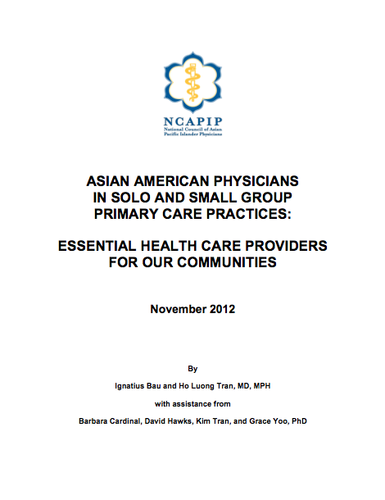


Slide 2


http://www.ncqa.org/Portals/0/HEDISQM/CLAS/Briefing/Small_Practices_Report.pdf

Slide 3
Project Background
Funded by U.S. Department of Health and Human Services Office of Minority Health
Collect data from Asian American, Native Hawaiian, and Pacific Islander primary care physicians in solo and small group practices serving Asian American, Native Hawaiian, and Pacific Islander patients
Data collected November 2011 – May 2012
Report issued November 2012
http://s3.amazonaws.com/NCAPIPportalDocfiles/NCAPIP_Report_Asian_Primary_Care_Practices.pdf

Slide 4
Primary Care Practices in the U.S.
84% primary care visits are at office-based practices
74% all ambulatory care visits are at practices with 5 or fewer physicians (31% are at solo practitioners)
70% internal medicine practices, 69% general/family practices, 52% pediatric practices are solo practitioners
Hing E, Uddin S. Visits to Primary Care Delivery Sites – United States, 2008. National Center for Health Statistics Data Brief No. 46 (2010)
Hsiao C-J, Cherry DK, Beatty PC, Rechsteiner EA, National Ambulatory Medical Care Survey: 2007 Summary. National Health Statistics Reports No. 27 (2010)
Hing E, Burt CW. Office-based Medical Practices: Methods and Estimates from the National Ambulatory Medical Care Survey. Advance Data From Vital and Health Statistics No. 383 (2007)

Slide 5
Primary Care Practices in the U.S.
17% primary care visits are paid by Medicare, 13% by Medicaid/Children’s Health Insurance Program, 4% uninsured
Half of all office-based practices have implemented an electronic health record (EHR) but only 37% of solo/2-physician practices have
Over 80% of office-based practices could qualify for HITECH Act EHR incentive payments
Hing E, Uddin S. Visits to Primary Care Delivery Sites – United States, 2008. National Center for Health Statistics Data Brief No. 46 (2010)
Decker SL, Jamoom EW, Sisk JE. Physicians in nonprimary care and small practices and those age 55 and older lag in adopting electronic health record systems. Health Aff. 2012;31(5):1-6
Bruen BK, Ku L, Burke MF, Buntin MB. More than four in five office-based physicians could qualify for federal electronic health record incentives. Health Aff. 2011; 30(3):472-479

Slide 6
Data Collection
Pre-focus group survey (44 primary care physicians) (responses online, by fax, by hand)
7 focus groups (54 primary care physicians + 19 other physicians in Honolulu, San Francisco, San Jose, Chicago, Dallas, Houston, New York
Among primary care physicians, 38% solo practitioners, 63% in practices of 5 or fewer physicians)
Post-focus group evaluations (62 responses, 85%
response rate)

Slide 7
Participating Physician Demographics
Focus group primary care physicians practiced internal medicine, family medicine, pediatrics
Focus group primary care participants were Chinese, Vietnamese, Filipino, Japanese, Indian, Burmese, White
66% of focus group primary care participants were men, 34% women

Slide 8
Participating Physician Demographics
Median years in practice = 22 years
66% speak languages in addition to English when seeing patients
3/4 have clinical staff who speak languages in addition to English
3/4 have administrative staff who speak languages in addition to English

Slide 9
Focus Group Discussions
“Becoming a primary care provider is a calling, it’s not for the money”
“The reason I became a physician was to help others”
“It’s a calling, we care deeply about our patients”

Slide 10
Focus Group Discussions
“I feel that I am just a referral doctor. How much I am paid depends more on the number of patients I see, not the care I provide”
“We try to run faster on a hamster wheel, and will just deliver hamster wheel care until we fall off”
“We will burn out, and no one will be happy, neither physicians or our patients”

Slide 11
Payers
88% have uninsured self-pay patients
64% serve patients without charge/on charity basis (average = 3.6% of patients)
69% have Medicaid/Children’s Health Insurance Program patients
76% have Medicare patients

Slide 12
Focus Group Discussions
Asian American, Native Hawaiian, and Pacific Islander patients face language and literacy barriers
Translations of forms and patient education materials “often bad, misleading, inaccurate”
There is “cultural ignorance and insensitivity” in health care

Slide 13
Focus Group Discussions
Asian American, Native Hawaiian, and Pacific Islander patients “don’t speak up”, “just put up with poor care”
Asian American, Native Hawaiian, and Pacific Islander patients “need to be better educated about their own health”
“My patients are very demanding, needy, and lack social support”

Slide 14
Electronic Health Records (EHR)
88% currently use EHR
59% implemented EHR in 2010 or earlier
95% have heard of HITECH Act EHR incentive payments
75% intend to apply for HITECH Act EHR incentive payments

Slide 15
Electronic Health Records (EHR)
Most frequent sources of information about HITECH Act are local medical societies, Centers for Medicare & Medicaid Services (CMS), other physicians
32% had signed participation agreement with Regional Extension Center
25% who had not yet signed participation agreement with Regional Extension Center intended to do so
38% knew other physicians who had already received their HITECH Act EHR incentive payments

Slide 16
Electronic Health Records (EHR)
Most frequent uses of EHR are to document demographic data and vital signs, track lab results, prepare office visit summaries, electronic prescribing
Least frequent uses of EHR are electronic reminders to patients, receiving hospital discharge instructions electronically

Slide 17
Focus Group Discussions
“Eventually everyone will have to implement an EMR”*
“EMRs are still the future of health care”
“EMRs are the way to go in the future, it’s a must”
*EMR vs. EHR

Slide 18
Focus Group Discussions
Physicians will retire rather than implementing an EMR
“EMRs are the worst thing to happen to health care”
EMR implementation is “like putting a rock in your mouth, you can grind it down, but it’s not really what you want to do”

Slide 19
Quality Improvement
54% receive their own performance data on quality measures (most frequently from health plans, medical groups/independent practice associations)
41% have received training on quality improvement (through CME, conferences, quality improvement initiatives)
45% have received technical assistance on quality improvement (most frequently from health plans)

Slide 20
Focus Group Discussions
Medical homes “are what everyone tries to do in primary care”
“I’m already a medical home, sending notes and following up with specialists, explaining lab results to my patients”
Medical homes are “what we have always done”

Slide 21
Focus Group Discussions
Concept of medical homes good but “won’t work financially, it can only work in a large medical group”
Medical homes “take away all the clinical decisions away from us”
“Maybe patients don’t want a medical home, they should be able to pick and choose their providers”

Slide 22
Focus Group Discussions
The concept of an accountable care organization (ACO) “scares me”
Unfair to be benchmarked against own past costs in accountable care organizations because average costs already low
“I am very disappointed to hear about ACOs and feel that if you join an ACO, you will lose control”

Slide 23
Focus Group Discussions
Our patients don’t know about the health care reform law, don’t realize what changes will happen
Asian language media is covering the health care reform law and its implementation
Concerns about misinformation and deliberate attempts to deceive consumers through unscrupulous marketing

Slide 24
Focus Group Discussions
“Our health care system is far sicker than our patients”
“The whole health system is broken, not just for Asian Americans”
“This is the time for health care transformation, what is our legacy?”
“There is no turning back, we are going forward with something different, we can’t be nostalgic”

Slide 25
Focus Group Discussions
“Every policymaker should spend a morning at a solo or small group practice to understand challenges in delivering health care today”
“We need to be at the table, to have a clear voice, not just grumble”
95% participants would participate in future surveys or focus groups

Slide 26
Limitations
Challenges in recruitment (need prior relationships and personal, repeated contacts)
No Native Hawaiian or Pacific Islander physician participants (but some participants serve Native Hawaiian and Pacific Islander patients)
Convenience sampling, not generalizable
Technical issues in matching survey responses (didn’t ask for names) with focus group participants

Slide 27
Recommendations
Recognize HITECH Act Medicaid-eligible providers* as “essential community providers” for “qualified health plans” in health insurance exchanges
Conduct culturally and linguistically appropriate outreach to impacted communities about health reform
Engage ethnic language media in educating community members about health care reform
*<30% Medicaid patients, 20% for pediatricians

Slide 28
Recommendations
Monitor CMS and state implementation of the Medicaid EHR incentive program to maximize participation by solo and small group practice primary care physicians
Develop and make available standardized, open-source, interoperable EHR solutions
Support customization of EHR templates

Slide 29
Recommendations
Impose more aggressive requirements for health information exchange
Develop and leverage culturally and linguistically appropriate patient-facing functions of EHRs to improve communication and engagement with patients, families, and caregivers
Educate and engage primary care providers about the benefits of medical homes

Slide 30
Recommendations
Provide technical assistance to solo and small group primary care practices on health care quality improvement using Regional Extension Centers, Primary Care Extension Centers, Community-Based Collaborative Care Networks, and Community Health Teams
Fund independent practice associations, minority physician organizations, and other physician-support entities to provide technical assistance to solo and small group primary care practices on health care quality improvement
Support training on quality improvement for clinical and administrative staff in solo and small group primary care physician practices

Slide 31
Dissemination
Conducted briefing for Office of Minority Health and Office of National Coordinator for Health IT
Conducted dissemination meetings in Honolulu, San Francisco, and Washington, DC
Some recommendations have been adopted
Some additional relevant data and publications on solo and small group physician practices

Slide 32
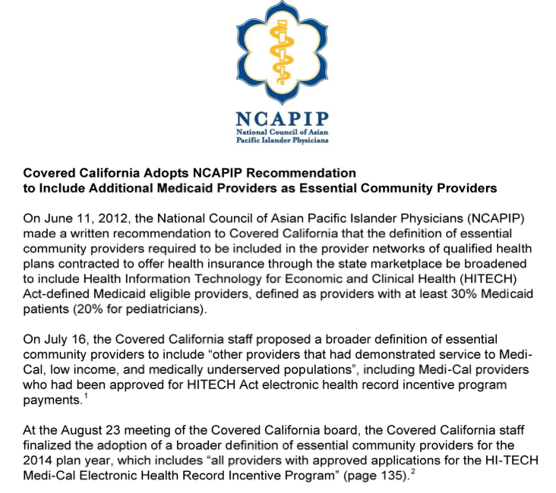

Slide 33
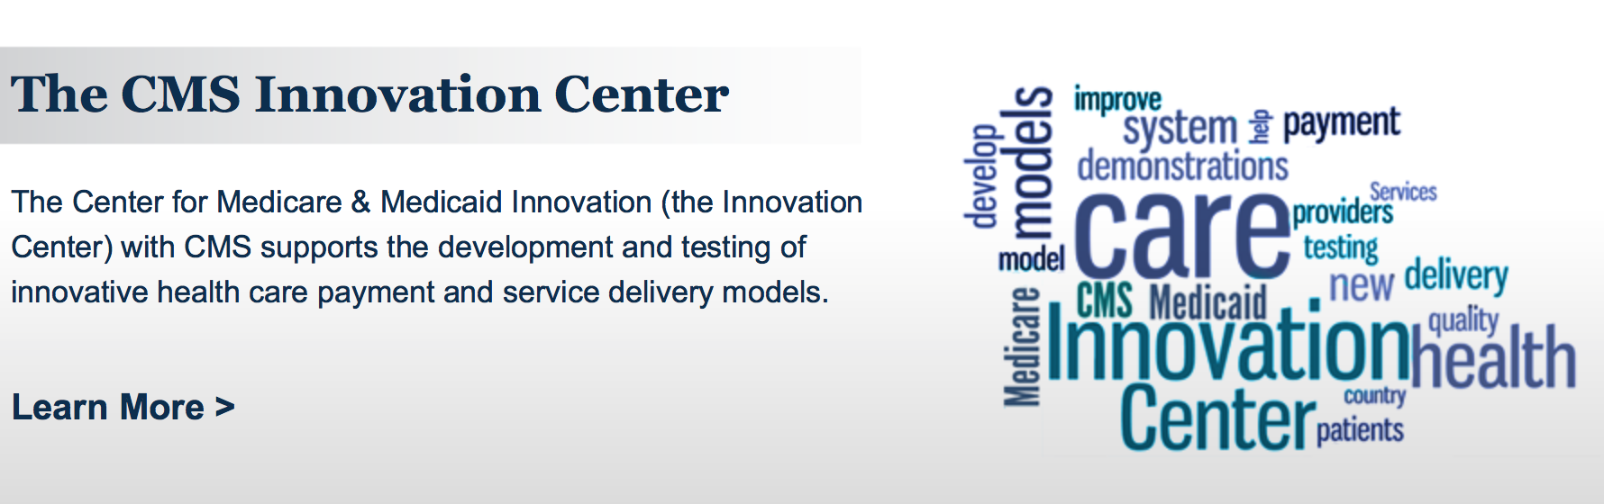
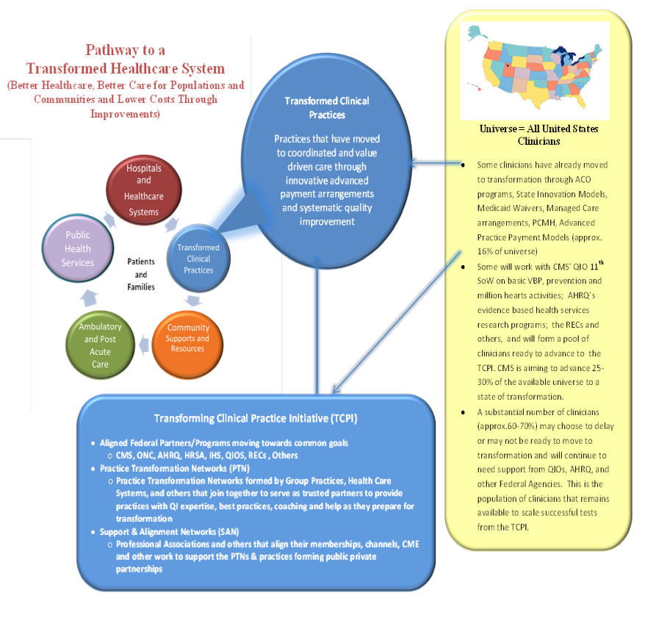
Transforming Clinical Practice
Initiative
Practice Transformation Networks
Support and Alignment Networks
Awards to be announced
summer 2015

Slide 34
In 2012, 69% primary care physicians were using an EHR
But only half of primary care physicians in solo practice were using EHRs, compared to 90% in practices with 20 or more physicians
Only 33% primary care physicians with EHRs are exchanging clinical summaries with other clinicians; only one-third are providing electronic access for their patients
Audet A-M J, Squires D, Doty MM,. Where are we on the diffusion curve? Trends and drivers of primary care physicians’ use of health information technology. Health Serv Research (2014);49(1 Pt. 2):347-360

Slide 35
In 2013, 78% office-based physicians were using an EHR
69% are participating or intend to participate in meaningful use incentive program
While 83% with EHRs are recording patient demographics, only 57% are providing patient reminders
Hsiao C-J, Hing E. Use and characteristics of electronic health record systems among office-based physician practices: United States, 2001-2013. Data Brief No. 143, National Center for Health Statistics (2014)

Slide 36
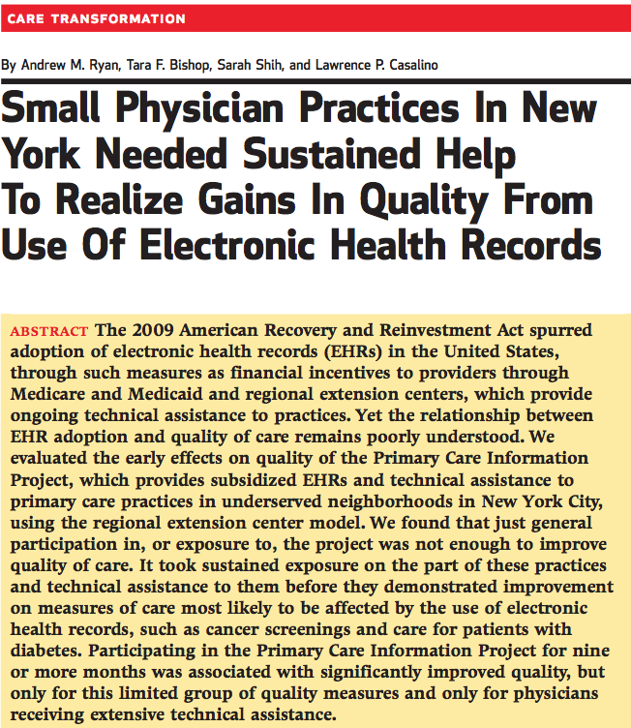
Ryan AM, Bishop TF, Shih S, Casalino LP. Small physician practices in New York needed sustained help to realize gains in quality from use of electronic health records. Health Aff. (2014)32(1):53-62

Slide 37
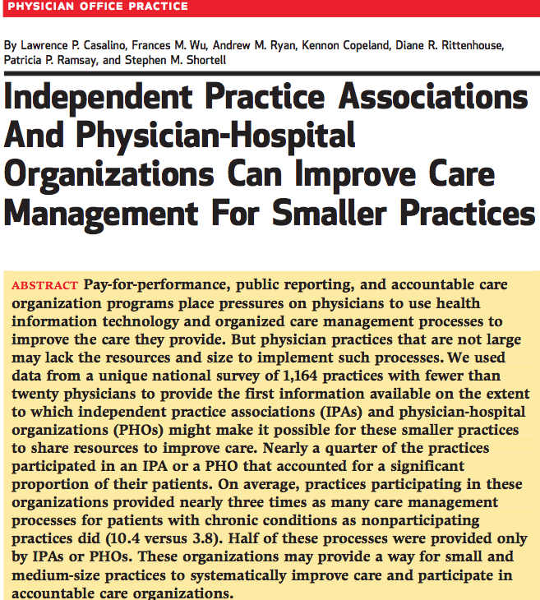
Casalino LP. Independent practice associations and physician-hospital organizations can improve care management for smaller practices. Health Aff. (2013)32(8):1376-1382

Slide 38
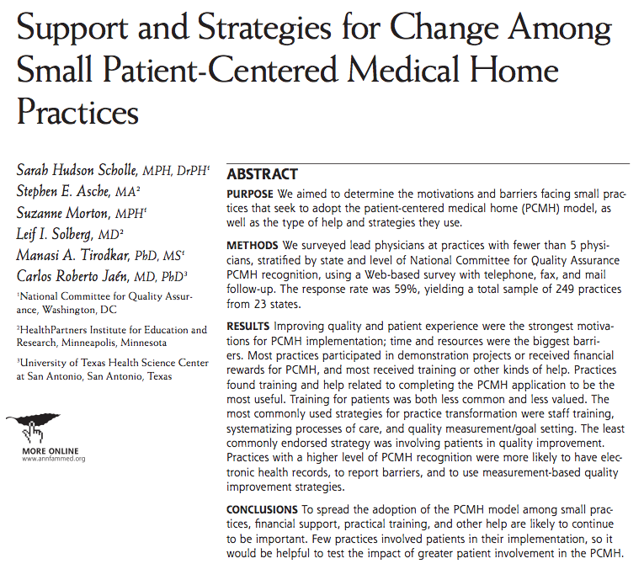
Scholle SH, Asche SE, Morton S, Solberg LI, Tirodkar MA, Jafu CR. Support and strategies for change among small patient-centered medical home practices. Ann Fam Med. (2013);11(Suppl 1):S6-S13

Slide 39
Follow-up Actions
Had follow-up discussions with physicians in Honolulu (August 2014) and in San Francisco (October 2014)
Planning additional follow-up discussions with physicians in Los Angeles, New York, and Chicago in 2015

Slide 40
Questions and Discussion

